Slide 1

Product Design Process

Slide 2

Product Design Process

Slide 3
Product Design Process
Conceptual Design
Embodiment Design
Detailed Design
Product Definition Specification

Slide 4
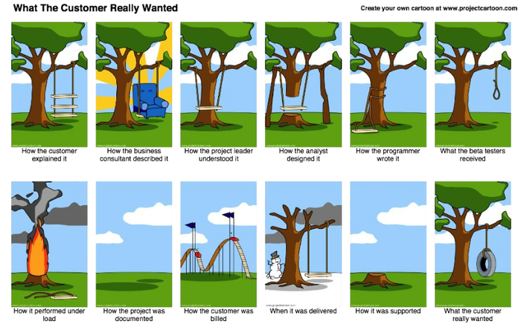
Product Definition Specification

Slide 5
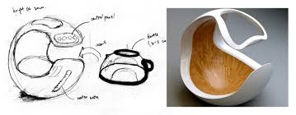
Conceptual Design

Slide 6
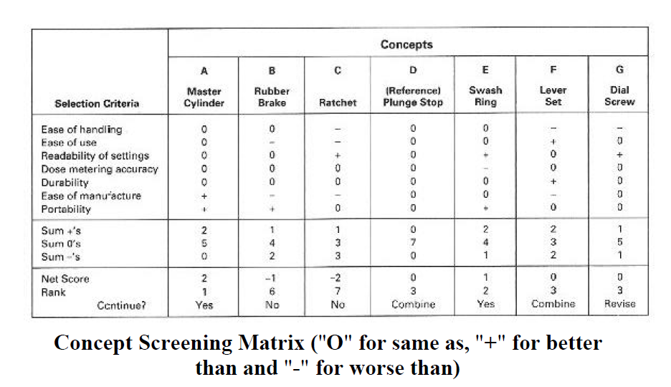
Conceptual Design

Slide 7
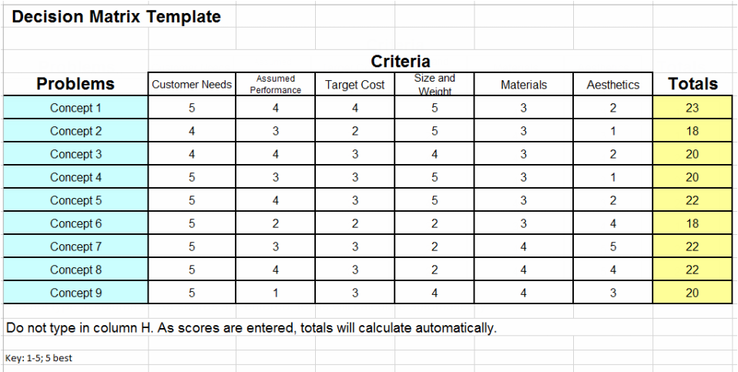
Conceptual Design

Slide 8
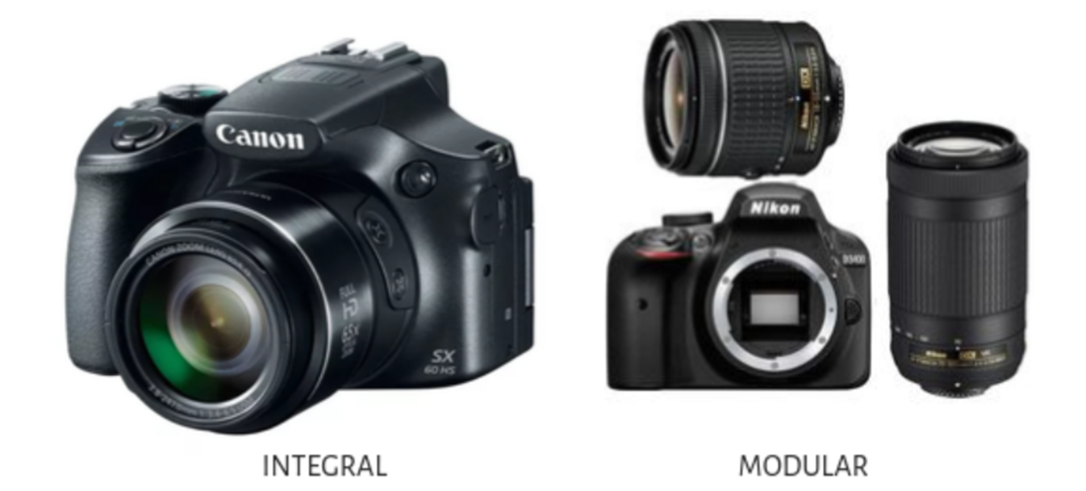
Embodiment Design
Product Architecture
Notes:
Embodiment design is one of the main stages of the product design process in which, the main engineering product design concept is developed as per the product design specification (PDS) and economic criteria to a stage where subsequent detailed design can lead directly into production.

Slide 9
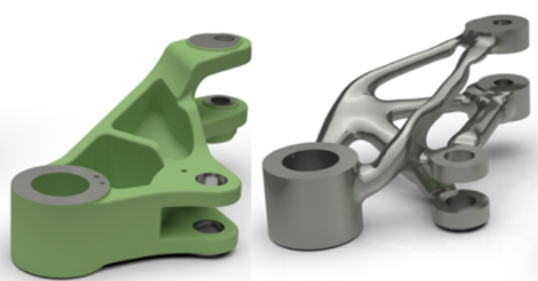
Embodiment Design
Product configuration
Notes:
Embodiment design is one of the main stages of the product design process in which, the main engineering product design concept is developed as per the product design specification (PDS) and economic criteria to a stage where subsequent detailed design can lead directly into production.

Slide 10
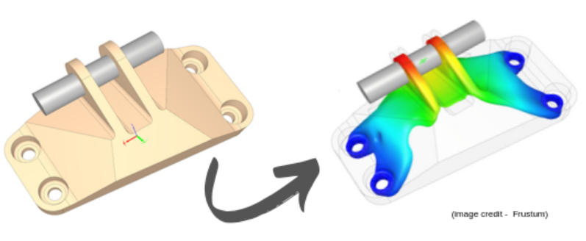
Embodiment Design
Parametric Design
Notes:
Embodiment design is one of the main stages of the product design process in which, the main engineering product design concept is developed as per the product design specification (PDS) and economic criteria to a stage where subsequent detailed design can lead directly into production.

Slide 11
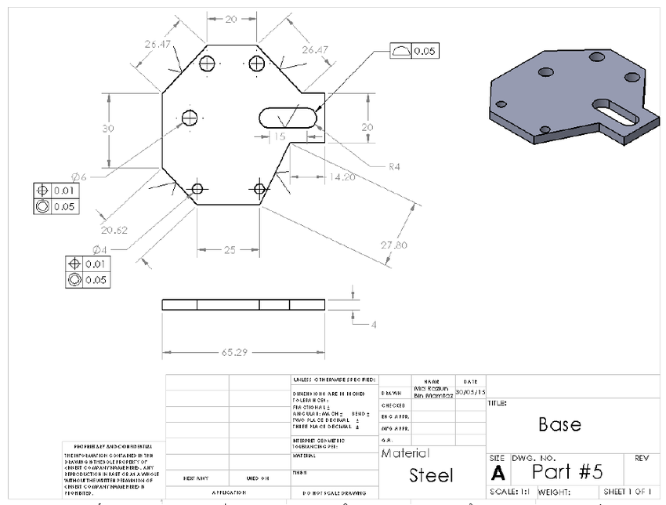
Detailed Design

